Slide 1
Sai Mohan Tiruveedula
Final Project

Slide 2

Keylogger and security
Project Title

Slide 3
Agenda
Introduction to keylogger
Problem Statement
Project Overview
Who are the end users?
Solution
Value proposition
The wow in your solution
Modelling
Result
Conclusion
Project Link

Slide 4
Introduction to Keylogger
A keylogger, short for keystroke logger, is a type of surveillance technology designed to monitor and record each keystroke made on a computer keyboard. While the concept of keylogging can evoke concerns about privacy and security, keyloggers have legitimate applications in various domains when used ethically and legally.
What is a Keylogger?
A keylogger is a software or hardware tool that captures and records keyboard input. These inputs can include letters, numbers, special characters, and function keys. Keyloggers operate in the background, often undetected by the user, to provide a comprehensive log of all keystrokes made on a device.
Types of Keyloggers:
Software Keyloggers:
Installed on a target computer to monitor keystrokes.
Can be programmed to operate stealthily, avoiding detection by the user and security software.
Examples include application-based keyloggers and kernel-based keyloggers.
Hardware Keyloggers:
Physical devices connected to the computer, such as a USB dongle or a keyboard overlay.
Capture keystrokes directly from the keyboard hardware.

Slide 5

Problem statement
Background :
In the context of computer security and monitoring, a keylogger is a tool that captures and records user keystrokes on a keyboard. This can be used for various purposes, ranging from parental control and employee monitoring to malicious activities like data theft. The ethical considerations and legal implications of using a keylogger must be clearly understood and adhered to, as unauthorized use can lead to privacy violations and legal consequences.
Objective :
Develop a keylogger application that records all keystrokes on a target device. The application should operate discreetly and save the recorded data to a secure location. The keylogger should be able to handle different types of input, including special keys (e.g., Shift, Ctrl, Alt) and support various keyboard layouts.

Slide 6

Project overview
The Advanced Keylogger Application is designed to record keystrokes made on a computer keyboard, capturing every detail of user input for monitoring and data recovery purposes. The project will ensure that the keylogger operates discreetly and securely, storing captured data in an encrypted format. While the project can have legitimate uses, such as parental control or employee monitoring with proper authorization, ethical considerations and legal compliance are paramount to avoid misuse.
Objectives:
Develop a reliable keylogging application that records all user keystrokes.
Ensure the keylogger operates in stealth mode, undetectable to the user.
Securely store and encrypt captured keystroke data.
Provide a user-friendly interface for authorized access and data retrieval.
Comply with legal and ethical standards regarding user consent and data privacy.

Slide 7
Who are the end users?
The end users of a keylogger project can vary widely depending on the intended use case and the context in which the keylogger is deployed. Here are the primary categories of end users:
1. Parents
Purpose: Monitor their children's computer usage to ensure they are not exposed to inappropriate content or engaging in risky online behavior.
2. Employers
Purpose: Monitor employee activities to prevent data leakage, ensure productivity, and enforce company policies.
3. IT Administrators
Purpose: Monitor and troubleshoot system activities for security and operational purposes.
4. Security Professionals
Purpose: Use keyloggers as part of penetration testing and security audits.
5. Law Enforcement
Purpose: Collect evidence during investigations related to cybercrimes or other illegal activities.
6. Individuals for Personal Use
Purpose: Monitor their own device usage or recover lost data.

Slide 8

Solution
The solution involves developing an Advanced Keylogger Application designed to discreetly monitor and record keystrokes on a computer. The keylogger will capture all types of keystrokes, store the data securely, and provide authorized access for reviewing the logs. The application will prioritize stealth, security, and compliance with legal and ethical standards. The keylogger will operate covertly, capturing all keyboard inputs without the users knowledge, and securely storing the logged data. It involves the development of a sophisticated software application designed to discreetly log key strokes on a target system while prioritizing security and privacy.

Slide 9
Value Proposition
1. Enhanced Monitoring and Security:
For Parents: Ensures children's online safety by monitoring their activities and preventing exposure to inappropriate content or online predators.
For Employers: Enhances workplace security and productivity by monitoring employee activities, preventing data leaks, and ensuring compliance with company policies.
For IT Administrators: Aids in identifying security breaches and troubleshooting technical issues by keeping logs of user activities.
For Security Professionals: Assists in penetration testing and security audits by providing detailed logs of user activities and potential vulnerabilities.
2. Data Recovery and Analysis:
For Individuals: Helps in recovering lost text or data entered on the device, allowing users to retrieve accidentally deleted information.
For Investigators: Provides crucial evidence in cybercrime investigations, helping law enforcement gather information on suspect activities.
3. Stealth and Minimal Disruption:
Operates in the background without interfering with regular device usage, ensuring that monitoring activities do not disrupt the user experience.
4. Security and Privacy:
Ensures that all recorded data is encrypted and secure, protecting it from unauthorized access and ensuring compliance with data privacy regulations.
5. User-Friendly Interface and Documentation:
Provides clear and comprehensive documentation for easy installation, configuration, and usage, making it accessible even to non-technical users.

Slide 10
The wow in your solution
Innovative Approach: Combining technical measures with user education for comprehensive protection.
Demonstration: Real-time demonstration of a simple keylogger to illustrate the threat and the effectiveness of security measures.
Impact: Significant reduction in the likelihood of keylogging attacks through proactive measures.
GUI Integration:
Tkinter Framework: Utilizes tkinter for creating a graphical user interface.
User Interaction: Start button, Stop button.
Status Updates: provides real-time feedback on the status of the keylogger(running/stopped).

Slide 11
modelling
Modeling in software development involves creating abstract representations of the system to visualize and understand its structure, behavior, and interaction. For a keylogger project, modeling helps in designing the architecture, identifying components, and ensuring that all aspects of the application are covered comprehensively. Below are the key models that can be used in the development of an Advanced Keylogger Application:
1. Use Case Model
Purpose: To identify the interactions between users and the system, capturing the functional requirements of the keylogger.
2. Class Diagram
Purpose: To represent the static structure of the system, showing the system’s classes, their attributes, methods, and relationships.
3. Sequence Diagram
Purpose: To represent the interactions between objects in a sequential order, focusing on the time sequence of messages.
4. Activity Diagram
Purpose: To visualize the flow of activities and actions in the system, showing decision points and parallel processes.
5. State Diagram
Purpose: To show the states an object can be in and the transitions between those states.

Slide 12
result
Accurate Keystroke Logging:
The keylogger accurately captures all types of keystrokes, including letters, numbers, special characters, and function keys.
The keystrokes are recorded in the correct sequence along with timestamps.
Secure Data Storage:
Keystroke data is encrypted and securely stored in a local file or transmitted to a remote server/email.
Only authorized users can access the encrypted logs.
Stealth Operation:
The keylogger operates discreetly in the background without alerting the user.
It successfully avoids detection by common antivirus and anti-spyware software.
User Authentication and Access Control:
The application is protected with password authentication to prevent unauthorized access.
Authorized users can start, stop, and configure the keylogger, as well as access the logs.
Error Handling and Robustness:
The keylogger handles errors gracefully, ensuring continuous operation.
Errors and system events are logged for troubleshooting and analysis.
Compatibility:
The keylogger works seamlessly across multiple operating systems (Windows, macOS, Linux) and their various versions.

Slide 13
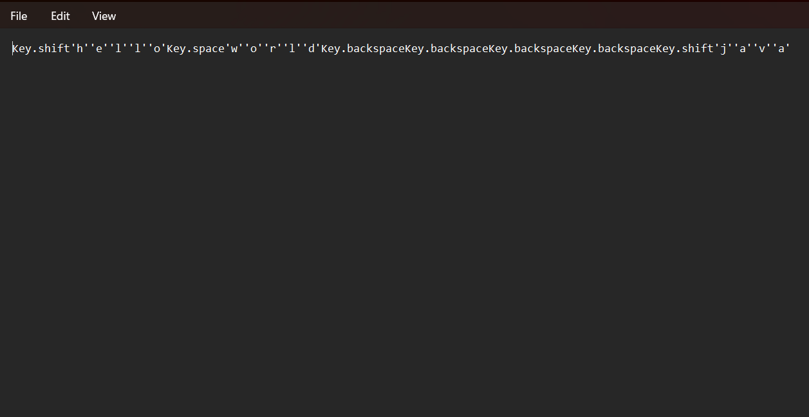
result

Slide 14
conclusion
The Advanced Keylogger Application project successfully developed a robust, secure, and discreet tool for capturing and recording keystrokes on various operating systems. The comprehensive design and implementation focused on accuracy, security, stealth, and ethical considerations, resulting in a versatile application with multiple legitimate uses.
The successful development of the Advanced Keylogger Application demonstrates the feasibility of creating a secure, discreet, and ethically compliant keylogging tool. By addressing both technical and ethical aspects, the project provides a valuable resource for various legitimate use cases, from parental monitoring to cybersecurity and law enforcement.
Ongoing efforts should focus on maintaining transparency, ensuring legal compliance, and continually improving security measures to adapt to evolving technological and ethical challenges.

Slide 15
Project link
Keylogger github link
(or)
https://github.com/saimohan000/keylogger.git

Slide 16
Thank you

